Slide 1


NYC Taxi and Limousine Commission (TLC) Analysis
Group 5
Jan Mollet
Deepali Krishna Kashyap
Kanchan Sadashiv Deore
Nidhi Nityanand Uchil
Shamitha K V
Yochana Boddepalli
Notes:
8

Slide 2
CRISP-DM: Business/Data Understanding
Notes:
8

Slide 3
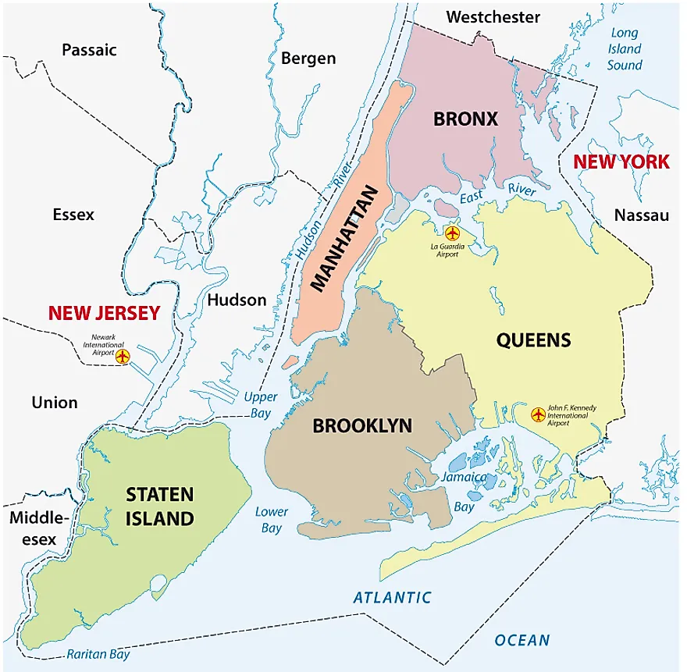
South of West 110th St and East 96th St
Notes:
1

Slide 4




NYC
Taxi & Limousine Comission
Since 1971
200k drivers
600 employees
Notes:
1

Slide 5





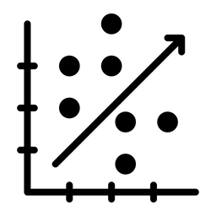
ANALYZE GREEN CAB USAGE PATTERNS AND IDENTIFY KEY FACTORS THAT INFLUENCE DRIVER INCENTIVES.
3986 (observations) x 20 (variables)
NA VALUES
DISTRIBUTION
OUTLIERS
DATA TYPE
CORRELATION
Notes:
1

Slide 6




FEATURE ENGINEERING
DO PASSENGER CHARACTERISTICS/ DECISIONS
INFLUENCE TIP AMOUNTS?
PEAK HOUR/ OFF-PEAK
DAY OF WEEK PICK UP
INCOME BOROUGH
TRAVEL TIME
Notes:
1

Slide 7
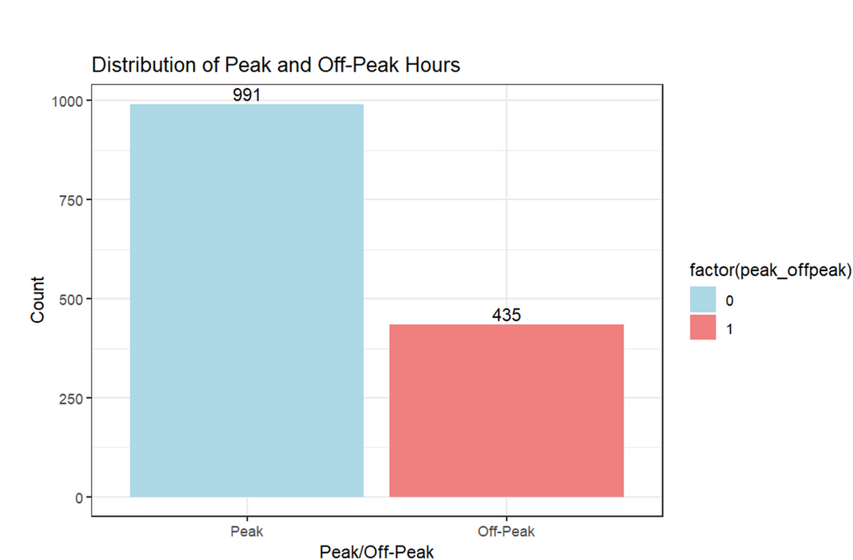
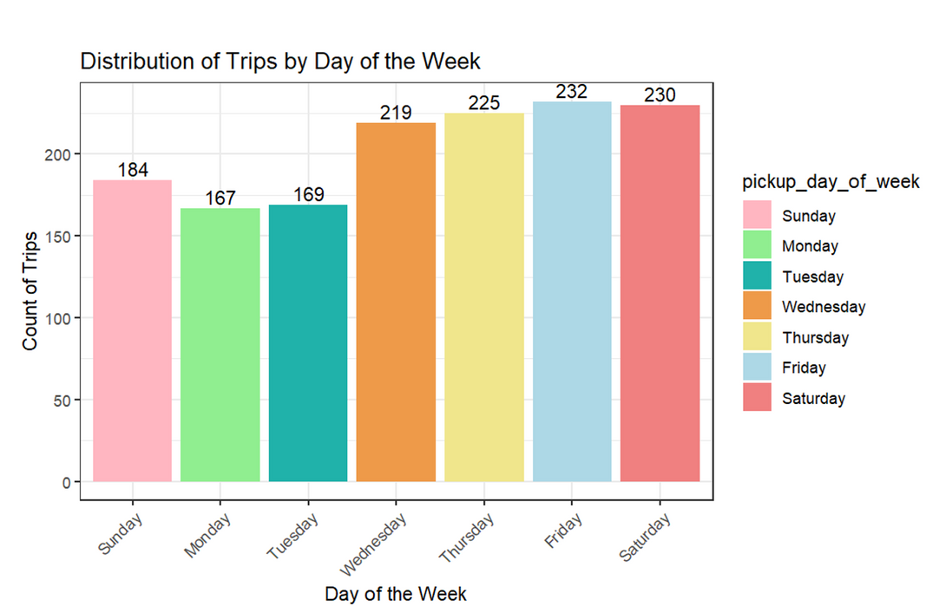
OBSERVATION OF FEATURE ENGINEERING 1
Notes:
3

Slide 8
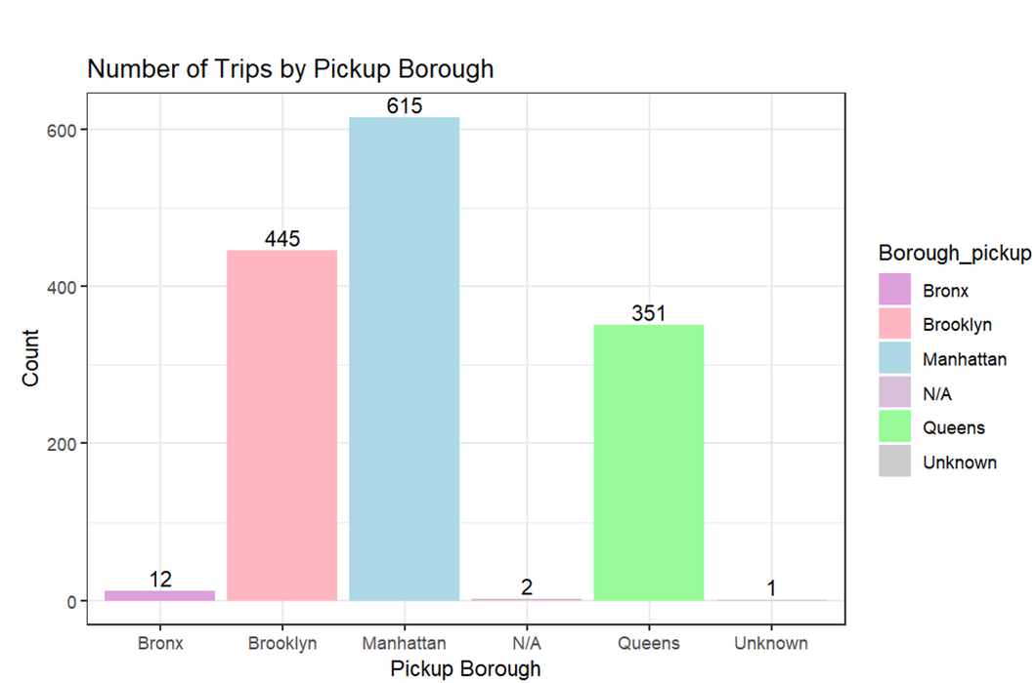
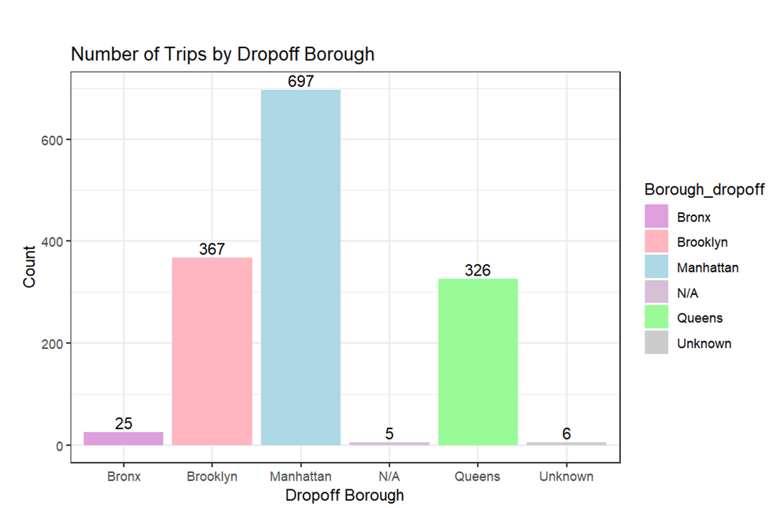
OBSERVATION OF FEATURE ENGINEERING 11
Notes:
5

Slide 9
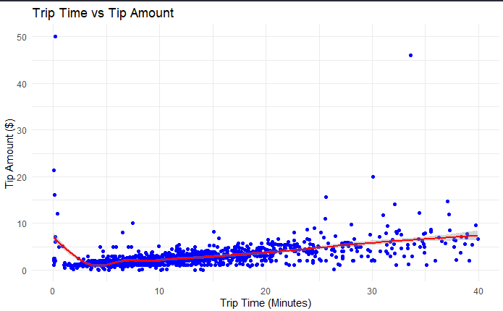
OBSERVATION OF FEATURE ENGINEERING 111
Notes:
4

Slide 10
CRISP-DM: Data Preparation
Notes:
8

Slide 11





CRISP-DM: DATA PREPARATION
Process the data
Normalise the data
Prepare the data for modeling
Encode the data
Notes:
6

Slide 12
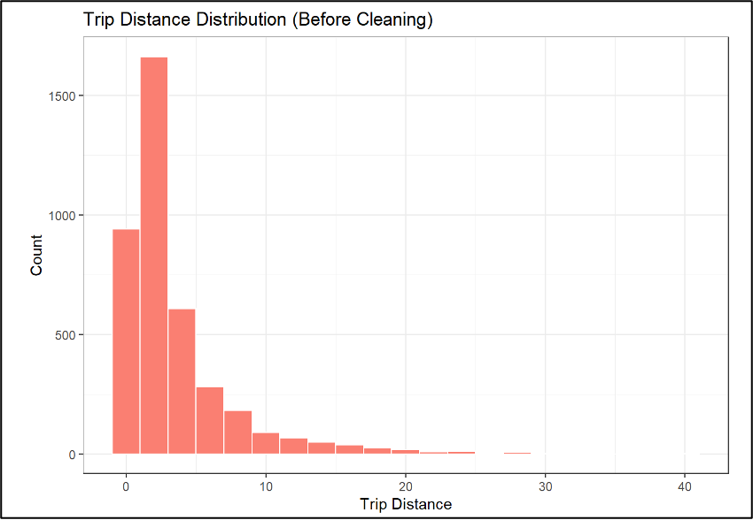
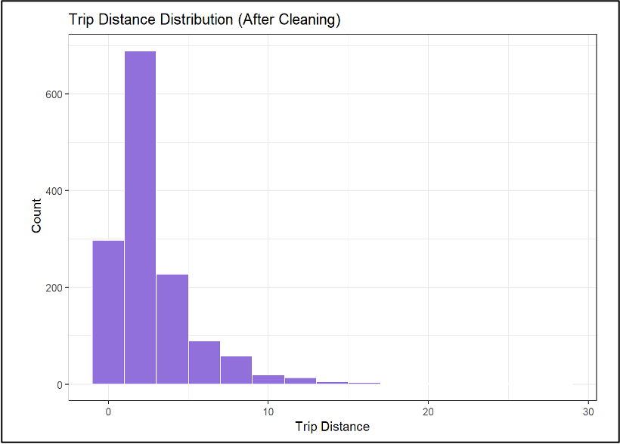
Data Cleaning
Notes:
5

Slide 13
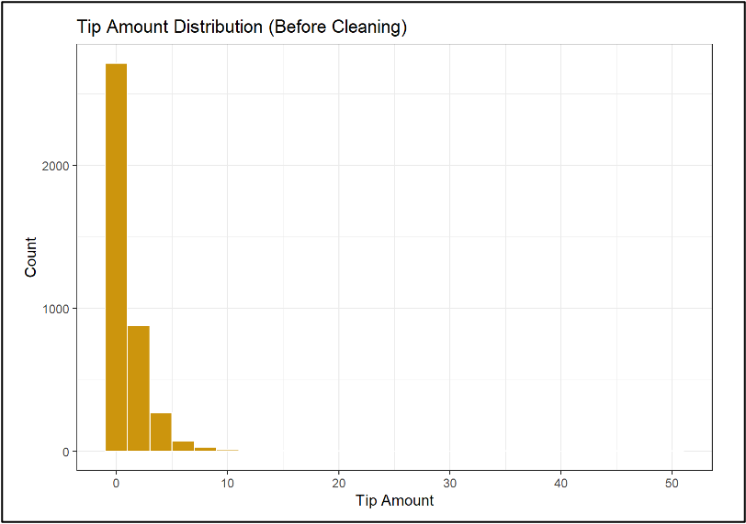
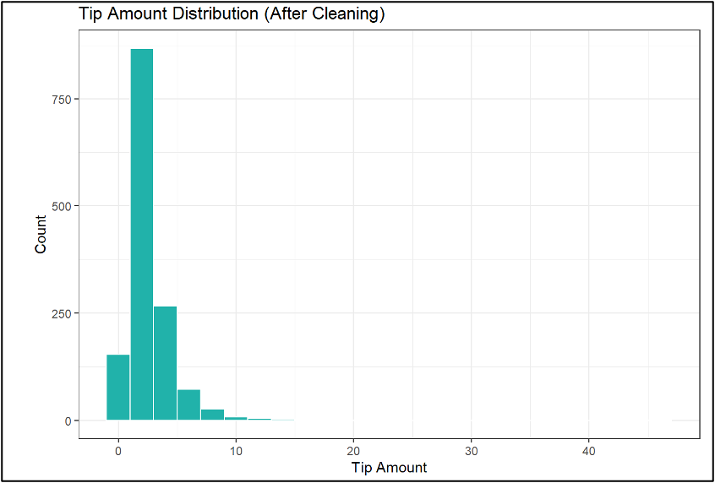
Data Cleaning
Notes:
4

Slide 14
CRISP-DM: Modeling
Notes:
8

Slide 15





Predicting NYC Taxi tips
using K - Nearest Neighbors (K-NN)
Who’s my nearest neighbor?
What is k-NN?
“For any new trip, find the most similar past trips and use their average tip to predict the new one.”
It’s ME!!!!!!
Think of it like asking:
"What did similar customers tip in similar situations?"
Notes:
3

Slide 16


Why is it Useful?
No heavy math – It learns from real trips, not assumptions.
Adapts to behavior – Accounts for patterns by day, borough, distance.
Business insight – Helps forecast tips & support pricing decisions.
Model Results (k = 5)
Mean Squared Error (MSE): ~$1.80
Most predictions are within a couple dollars of actual tips
Performs best on typical trip patterns (short to moderate distance)
k-NN offers a simple, transparent, and effective way to estimate tip amounts especially useful for operations, planning, or incentive strategy.
Notes:
6

Slide 17
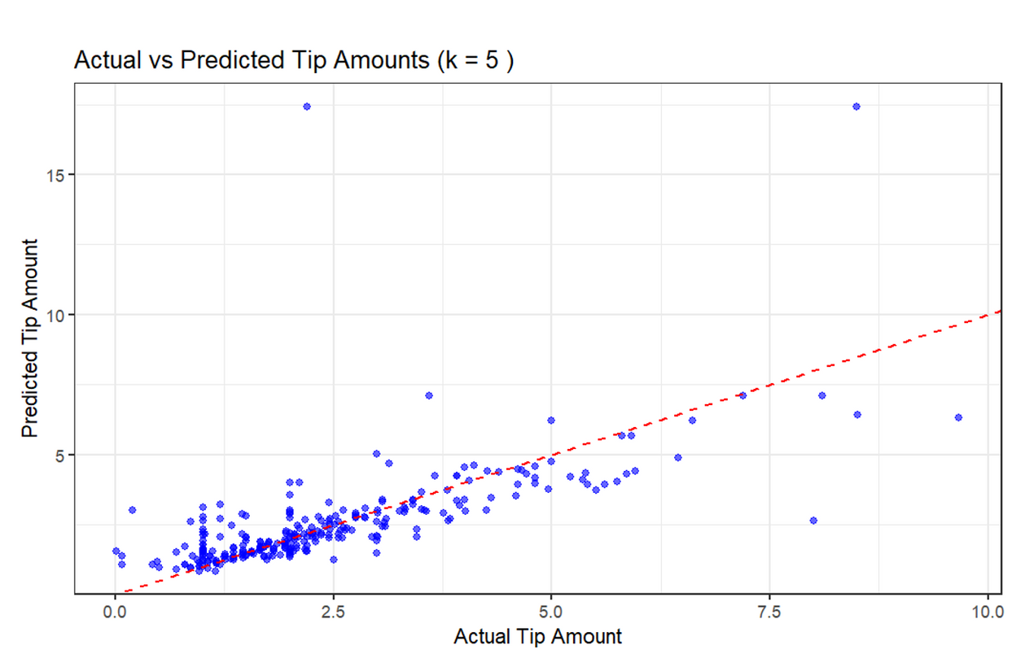
NYC Taxi Tip Amount Prediction Analysis - KNN Model
This plot visualizes how well our predictive model estimates tip amounts, using a K-Nearest Neighbors with k = 5. Each blue dot represents a single trip, plotting the actual tip amount on the x-axis versus the predicted tip amount on the y-axis.
Key Takeaways:
Strong clustering near the red line indicates that the model is performing well for most common tip ranges (typically under $5).
Overall trend is consistent, reinforcing that our model effectively captures the general tipping behavior.
Why Does This Matter?
Well, if we can predict tips more accurately, we’re opening the door for stuff like personalized incentives for drivers, better customer recommendations, or even fine-tuning service strategies to boost those tips! It’s all about smart predictions leading to happy customers and better service!
Notes:
5

Slide 18
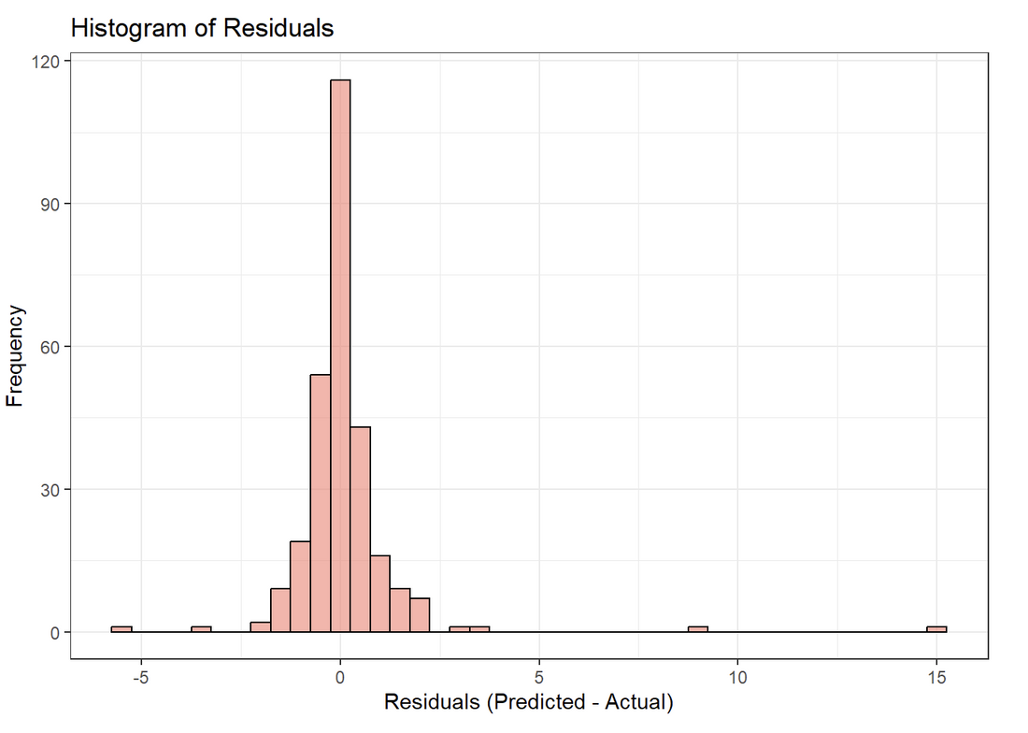
NYC Taxi Tip Amount Prediction Analysis - KNN Model
This histogram shows the residuals—the difference between our predicted tip values and the actual values. Essentially, it tells us whether we’re hitting the mark or missing it!
Why This Matters?
Residuals are like the feedback our model gives us. A narrow peak around zero indicates that most predictions are pretty spot-on, which means we can trust the model to make accurate tip predictions in most cases.
What does this mean for us?
This means our model is highly reliable for applications where predicting tipping behavior accurately is key. Whether it's improving service strategies or optimizing pricing, this level of accuracy means our model can make smarter, data-driven decisions!
What We Can Do Next?
While the model is already effective, improving the small errors will make it even more accurate.
Notes:
3

Slide 19
CRISP-DM: Evaluation
Notes:
8

Slide 20
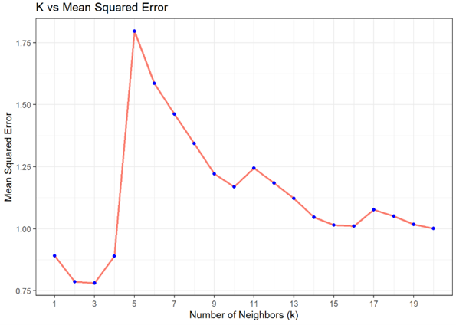
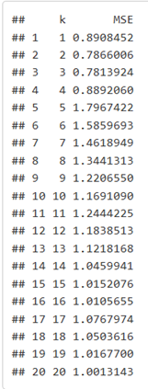
Evaluating Optimal ‘k’ using Mean Squared Error
Model Assessment : Tested 20 different k values using knn.predict() and evaluated each with MSE to measure prediction accuracy.
Model Selection : Lowest MSE (~0.781) observed at k = 3, making it the most optimal. Higher k values led to increased error.
Visual Insights : The MSE vs. k plot shows a sharp drop until k = 3, then rises and slowly declines demonstrating the bias-variance trade-off.
Business Fit : Confirmed that the model is generalizable, avoids overfitting, and is practical for real-world deployment.
Decision-Ready Outcome : k = 3 is the best choice offering balanced accuracy and stability for predicting future tip amounts.
Notes:
4

Slide 21





Strength: The model achieved its best performance at k = 3, with the lowest MSE, showing strong predictive accuracy for tip amounts.
Limitations: Feature Sensitivity: Performance depends heavily on proper feature scaling, as KNN uses distance metrics.
Curse of Dimensionality: KNN may perform poorly with sparse or high-dimensional data.
Efficiency: It’s computationally intensive, especially on larger datasets, since predictions use the full training set.
Recommendation:
KNN works well in this scenario but needs further testing and cross-validation before deployment. For large-scale or real-time use, consider more scalable models like decision trees or ensemble methods.
Notes:
6

Slide 22
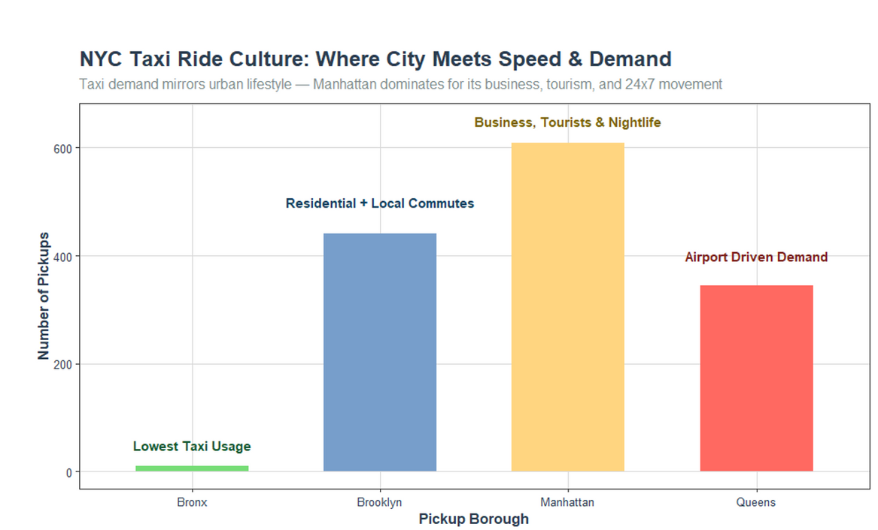
NYC Taxi Ride Culture: Where City Meets Speed & Demand
Taxi usage across NYC boroughs:
Manhattan leads in taxi pickups, driven by business, tourism, and nightlife. Brooklyn has strong taxi demand for residential and local commuting. Queens sees high taxi usage due to airport travel to JFK and LaGuardia. The Bronx has the lowest taxi demand, likely due to greater reliance on public transportation or personal vehicles.
What This Tells Us About NYC’s Taxi Culture?
Manhattan’s Taxi Dependence: The dominance of Manhattan in taxi usage highlights its pivotal role in the city’s economy, culture, and tourism. Taxis here cater to both everyday needs and visitors from all around the world, making them a crucial part of NYC’s transportation ecosystem.
Local vs. Tourist Demand: Boroughs like Brooklyn and Queens have a more localized demand. While Brooklyn taxis are primarily used for commuting and residential needs, Queens caters significantly to tourists and travelers heading to the airports. These boroughs show how taxis are tailored to serve different local lifestyles.
Public vs. Private Transportation: The contrast between the Bronx and other boroughs could suggest a preference for alternative transportation options in less central areas, where taxis aren’t the primary mode of travel.
Notes:
4

Slide 23
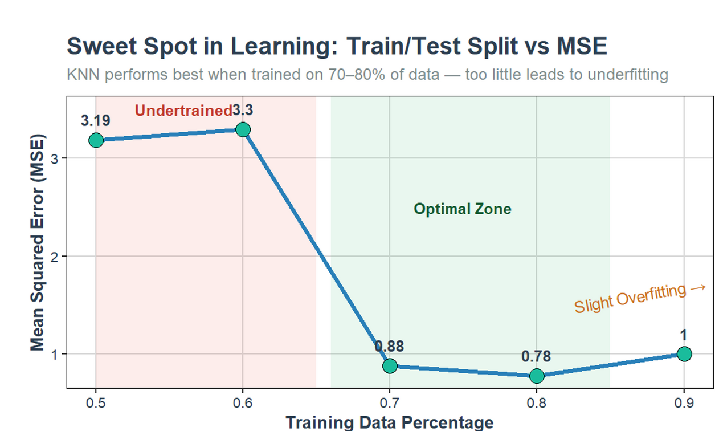
Optimal Train/Test Data Split - KNN Model
The graph explores the relationship between the percentage of data used for training (versus testing) and the model’s Mean Squared Error (MSE) in the context of the k-Nearest Neighbors (k-NN) regression model. The goal is to find the optimal train/test split that minimizes prediction error while avoiding overfitting or underfitting.
Undertraining Zone (<70% Training Data):
High MSE (~3.19), indicating underfitting. The model lacks enough data to learn patterns, leading to poor predictions.
Optimal Zone (70-80% Training Data):
Low MSE (~0.78), where the model performs best. It has enough data to learn well without overfitting, making it reliable and generalized.
Overfitting Zone (>90% Training Data):
Slight increase in MSE (~0.88), signaling overfitting. The model becomes too tailored to the training data, capturing noise and reducing its ability to generalize to new data.
In short, 70-80% training data strikes the best balance for accurate and generalized predictions.
Notes:
5

Slide 24


Thank you!
Notes:
8

